Slide 1
Creating a Windows Installer File

Slide 2
Executable File
An executable file is a binary file that contains instructions only the machine can understand and execute. The commands stored in the executable file are known as machine language.
Along with the executable file, an application requires support files. The executable file will run on the system on which it was developed, because the support files are there.
Under the project’s file, there are two folders named Bin and Obj. Inside the Obj folder there is a subfolder named Debug. This is where the executable file resides having the same name as the project name and has the extension .exe.
Distributing just an executable file isn't going to be any good, because the executable file requires support files. If the latter are not installed on the target system, then the executable file is not going to work. The file will be executed only on a system that has Visual Studio.NET on it.

Slide 3
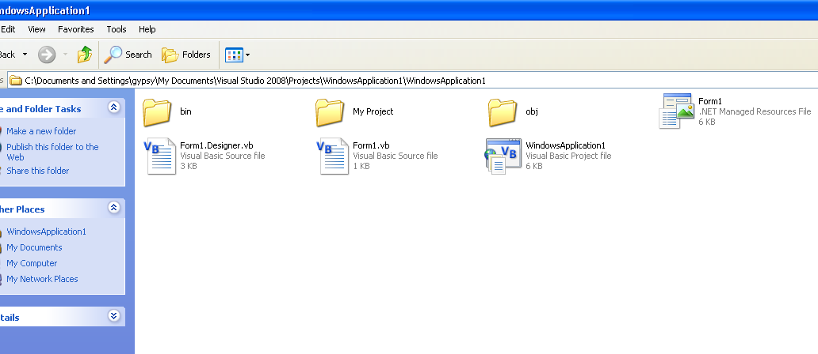
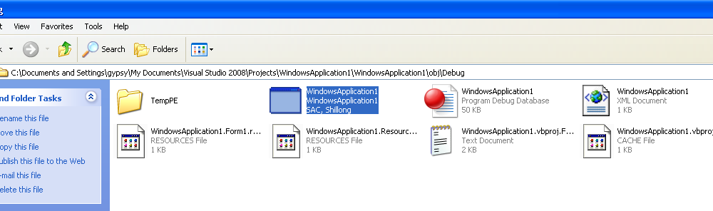
Executable File

Slide 4
Types of VB Project Version
The folder Debug contains the Debug version of the executable. To change the project’s configuration, select Build → Configuration Manager.
Change the setting of the configuration to Release. Build the project again and check that under the Obj folder, a Release subfolder will be created.
Difference between the two versions of the executable file:
  Debug – Debug files contain symbolic debug information.
  Release – The Release configuration executes faster as it does not contain any debug information.

Slide 5
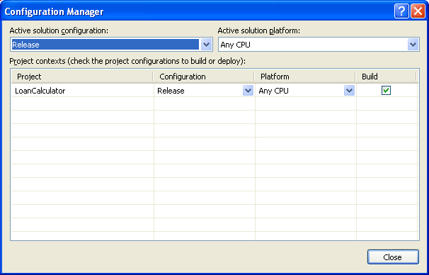
Configuration Manager

Slide 6
Windows Installer File
It has the extension .msi
Such files will allow distribution of your Windows Applications to clients/users without revealing your source code.
An executable file is nothing but a Setup File where users can install in their systems
Eventually, all the support files will become part of the operating system, and then we will be able to distribute a single EXE file (or a number of files). This hasn’t happened with Windows 2000 or Windows XP and won’t for some time. Until it does, we must provide our own installer.

Slide 7
Setup Projects
Setup Projects allow you to create installers in order to distribute an application.
The resulting Windows Installer (.msi) file contains the application, any dependent files, information about the application such as registry entries, and instructions for installation.
When the .msi file is distributed and run on another computer, you can be assured that everything necessary for installation is included
If for any reason the installation fails (for example, the target computer does not have the required operating system version), the installation will be rolled back and the computer returned to its pre installation state.

Slide 8
Steps to create a Setup/Executable File
Create a Windows Application that you want to distribute
When it is completed, then create the setup file
To do this, open that Windows Application
Then, goto File->Add->Project
  This will open a dialog box which will ask you for the type of project
  In the left-hand panel, select Other

Slide 9
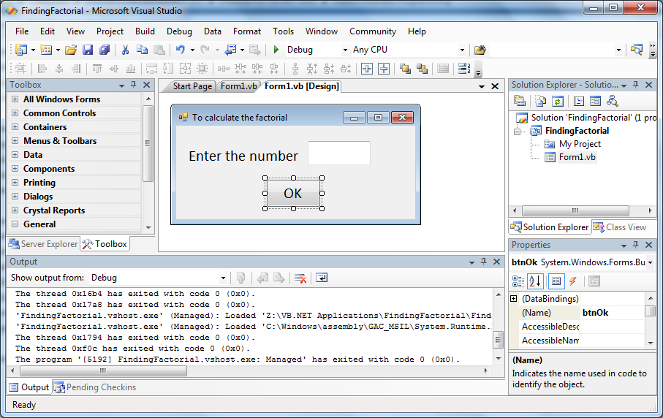
Windows Application

Slide 10
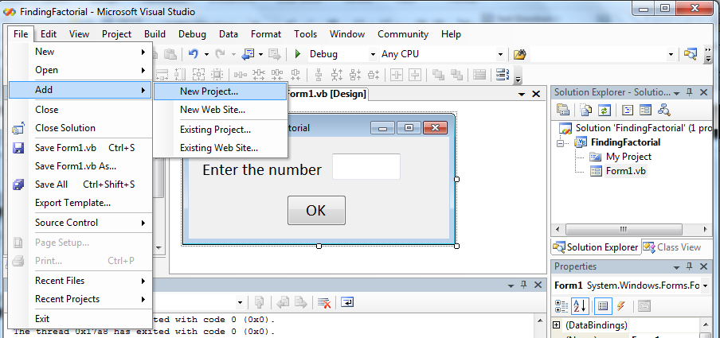
Add New Project

Slide 11
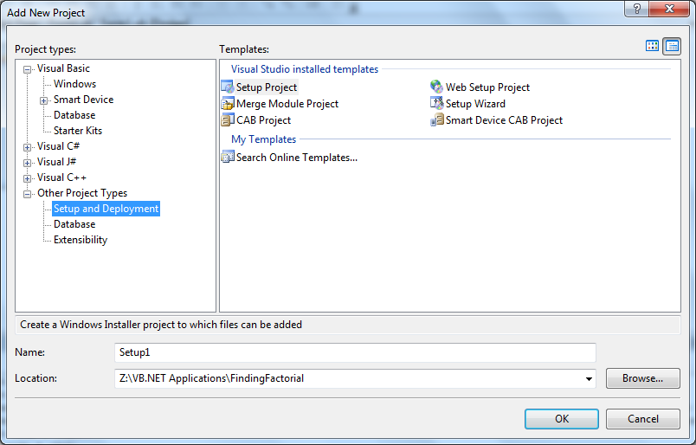
Select Other Project Types

Slide 12
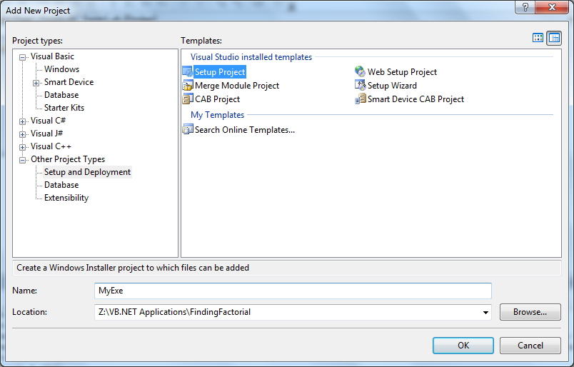
Select Setup Project & Rename Project
Click ok to create EXE file

Slide 13
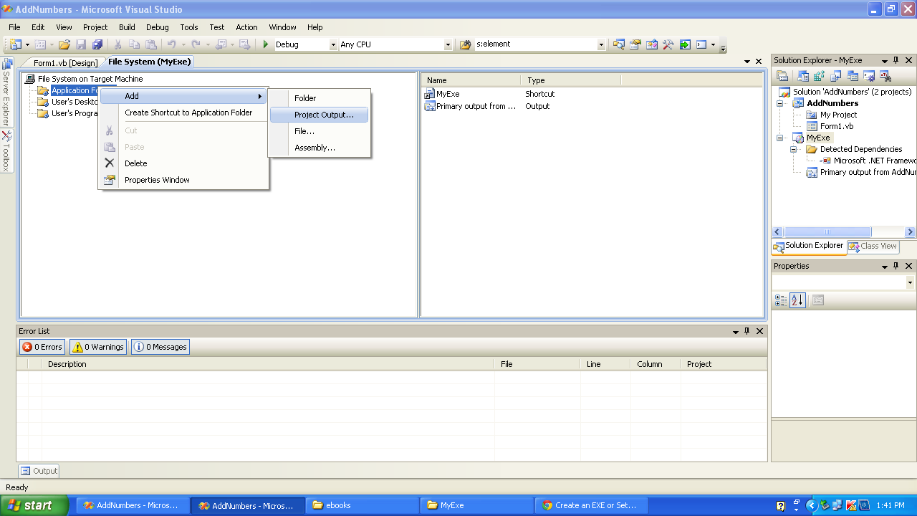
Add Project Output -> Primary Output

Slide 14
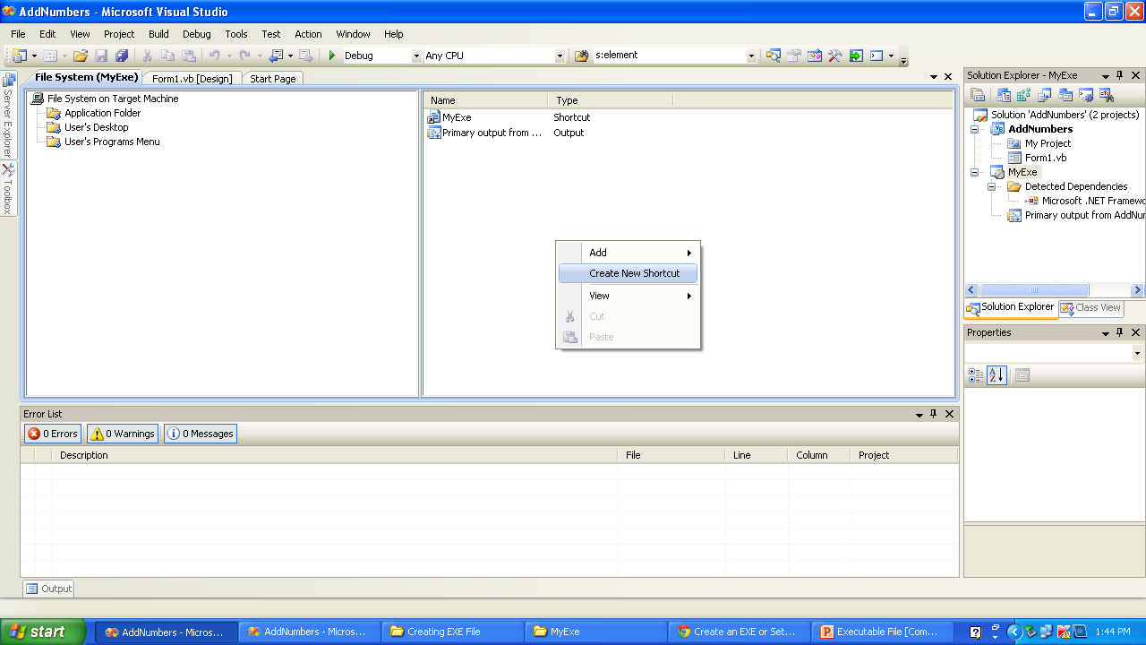
Creating Shortcut for Setup File

Slide 15
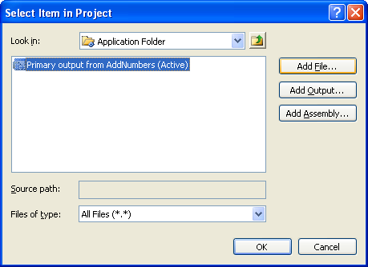
To create Shortcut Add Primary Output
The Primary Output is in the Application Folder and click OK

Slide 16
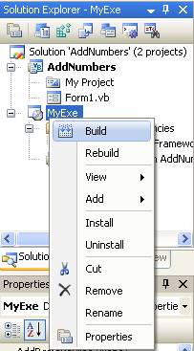
Build Setup Project to create the EXE File
The file will be placed the Setup Project Folder, either in the Release or Debug Folder depending upon the settings chosen

Slide 17

Executable Files on creation
These can be distributed to clients without the need for giving the source code

